Slide 1

To supply leftover food to poor
A salesforce-based project
Deiva M

Slide 2
introduction
Food wastage problem.
Why use Salesforce CRM? (managing donors, volunteers, distribution).
Objective: Build an app to connect donors with volunteers and needy.

Slide 3
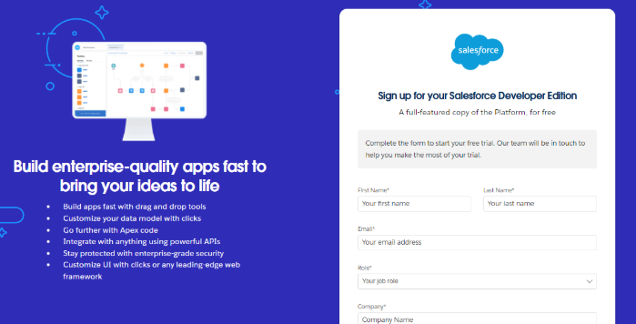
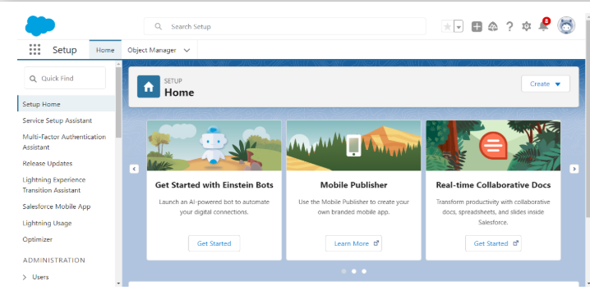
Salesforce Developer Account Creation
Importance: base platform for building the solution.

Slide 4
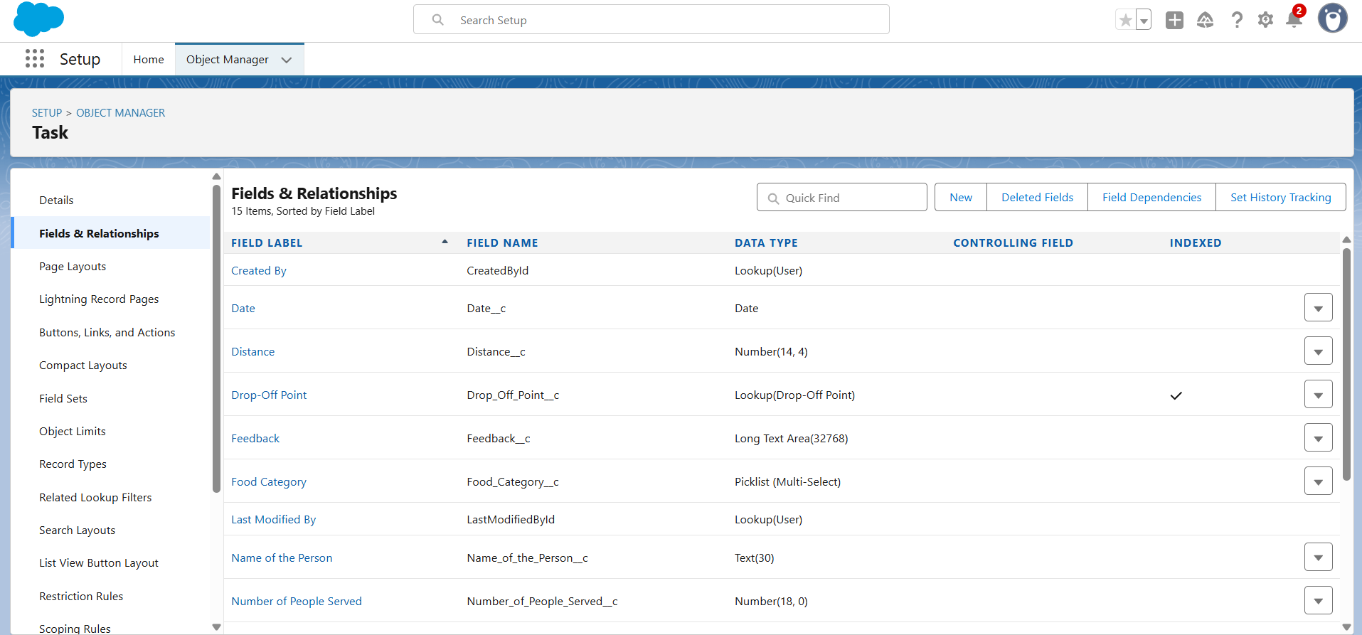
Task Object and field Creation

Slide 5
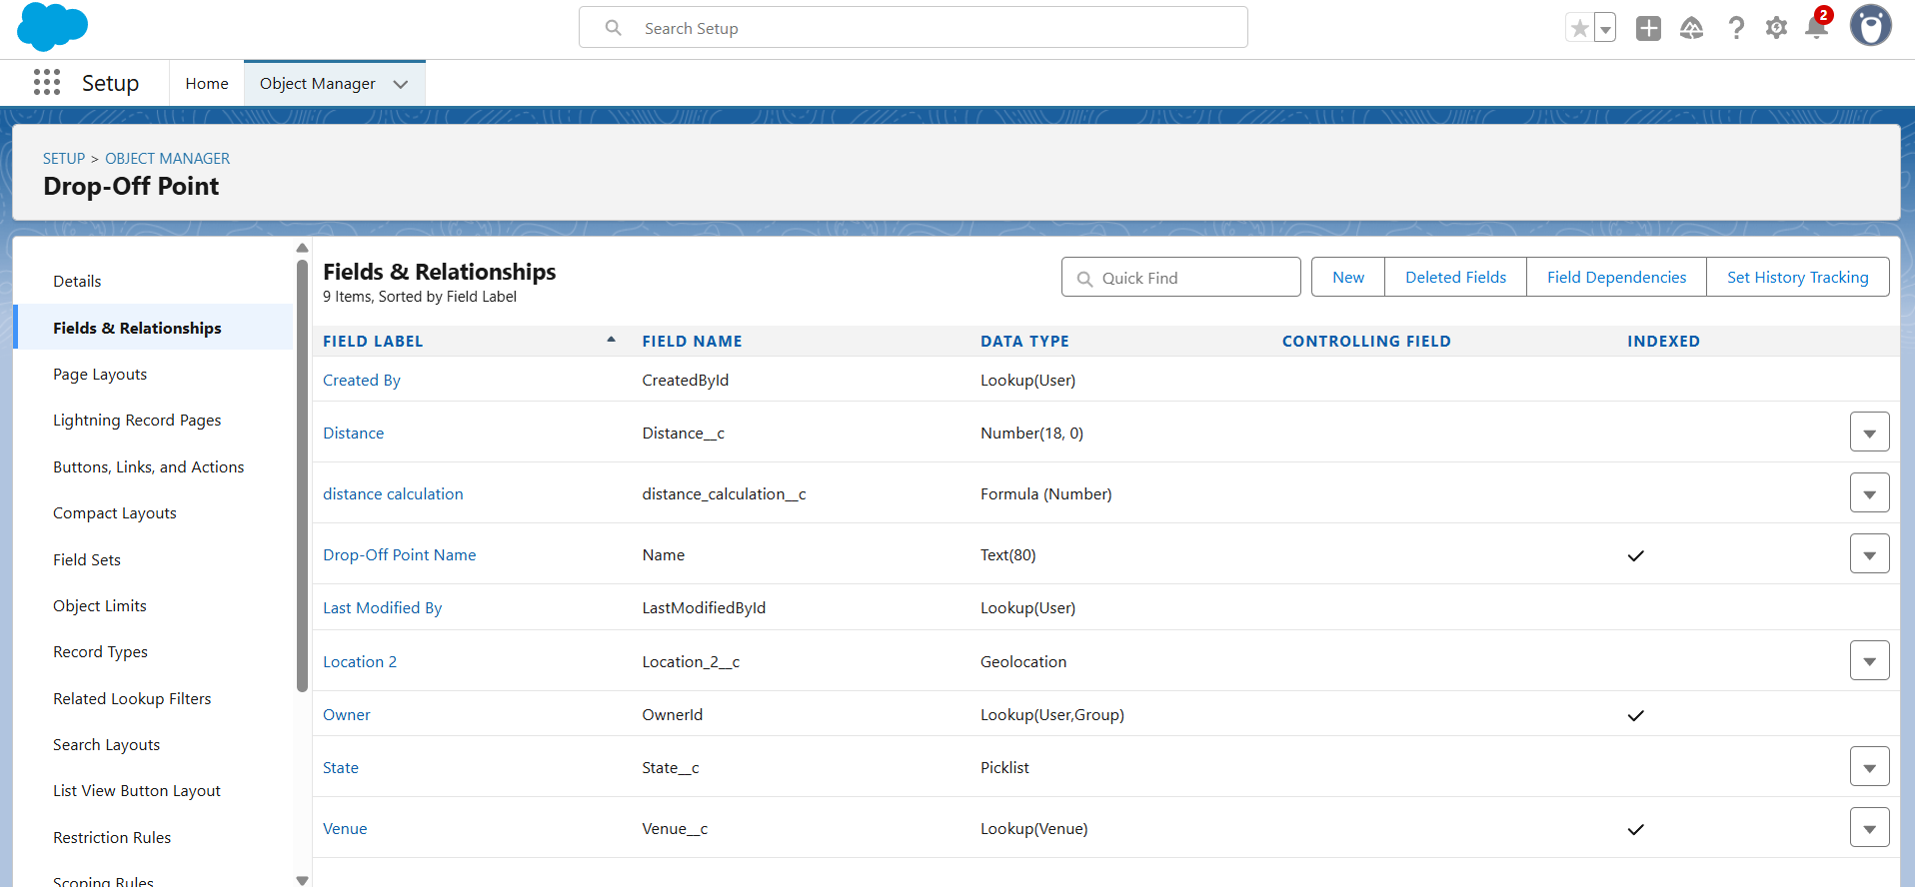
drop-off point Object and field Creation

Slide 6
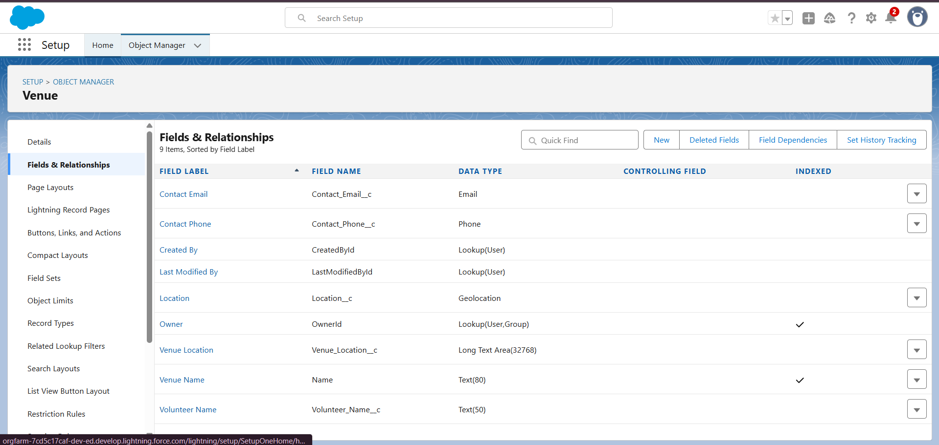
Venue Object and field Creation

Slide 7
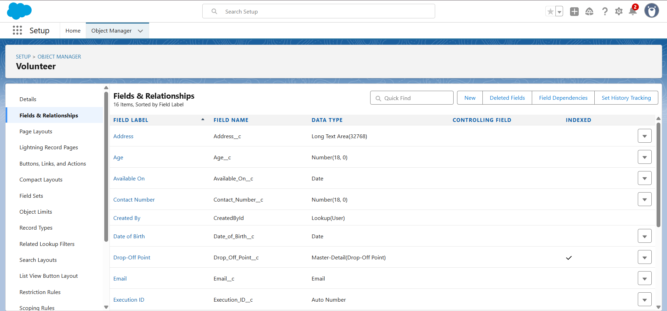
volunteer Object and field Creation

Slide 8
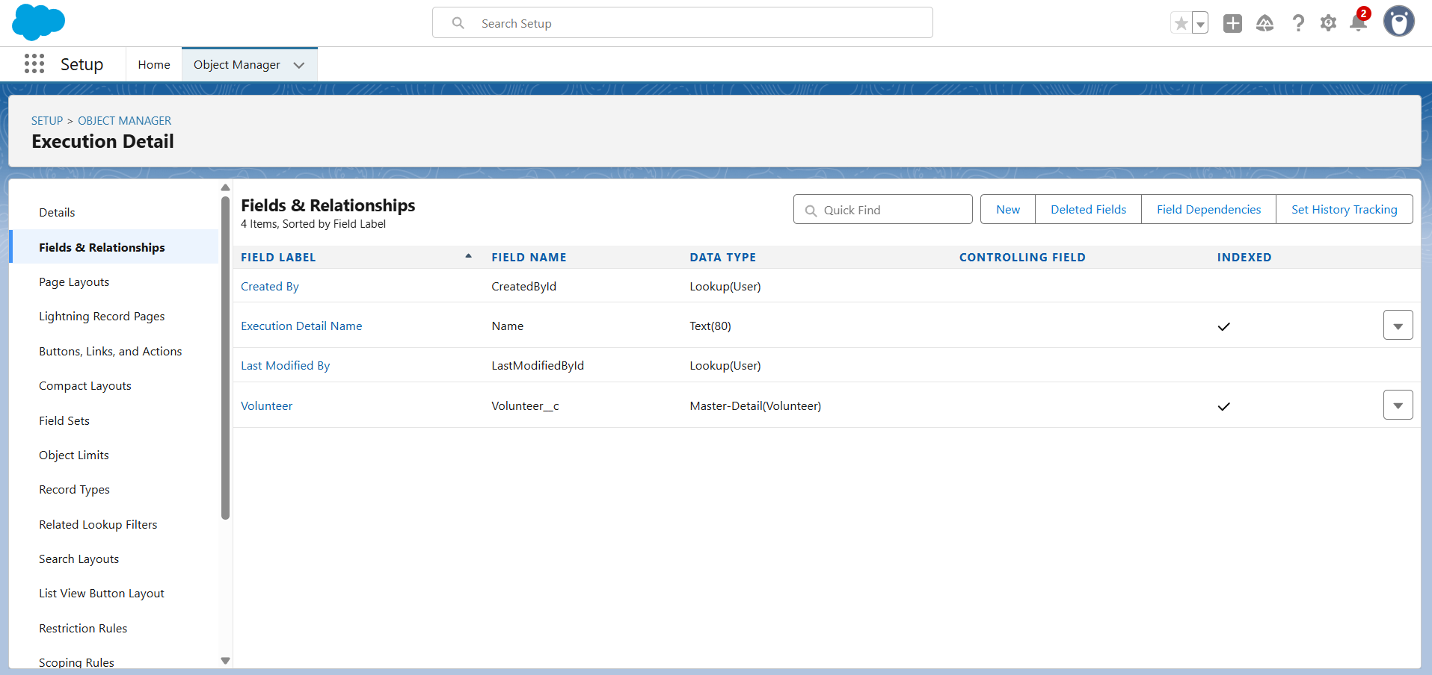
Execution detail Object and field Creation

Slide 9
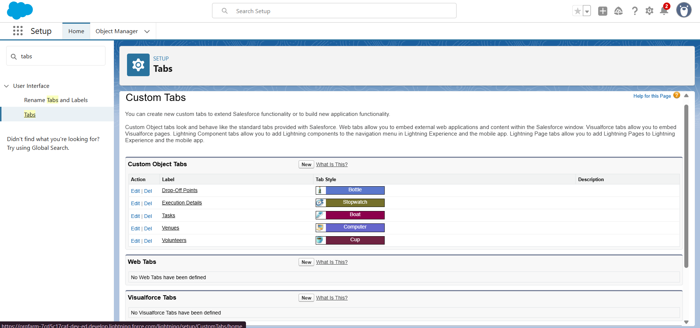
Tabs

Slide 10
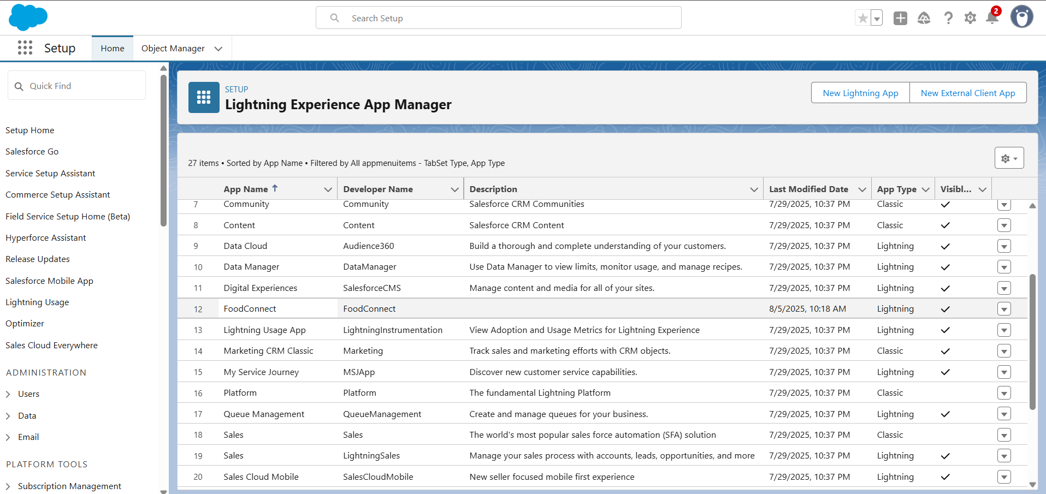
The Lightning App
App name: Food connect

Slide 11
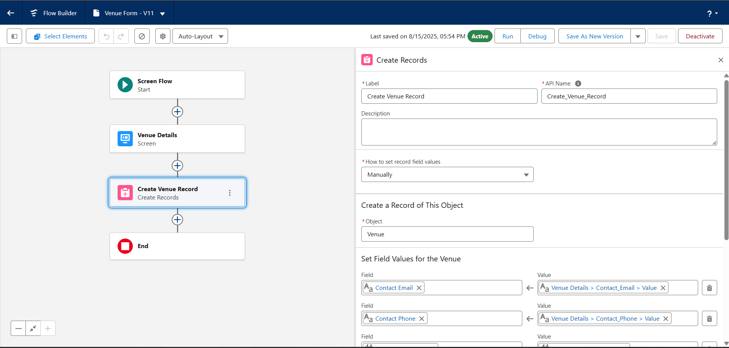
Flows
Flow used for automation

Slide 12
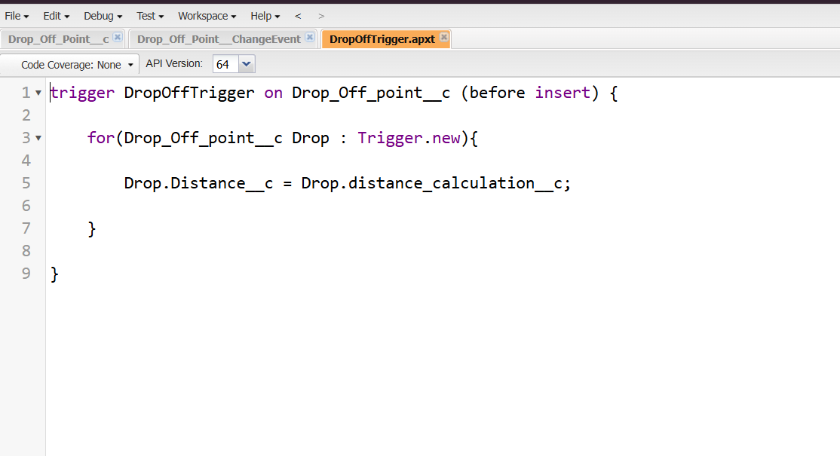
Apex trigger for custom logic.

Slide 13
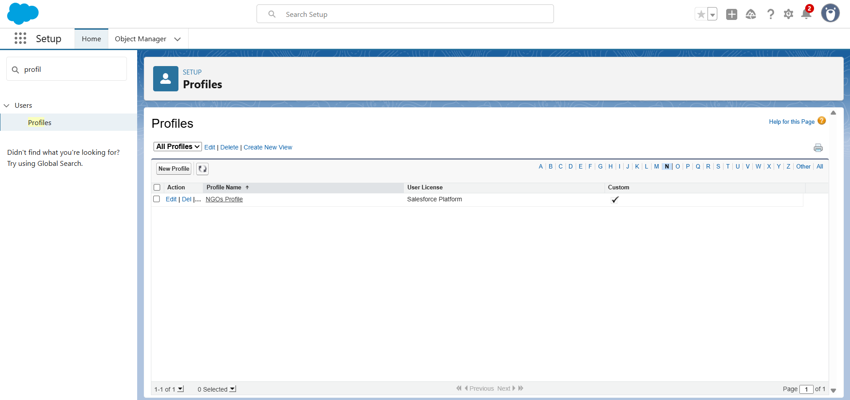
Profiles

Slide 14
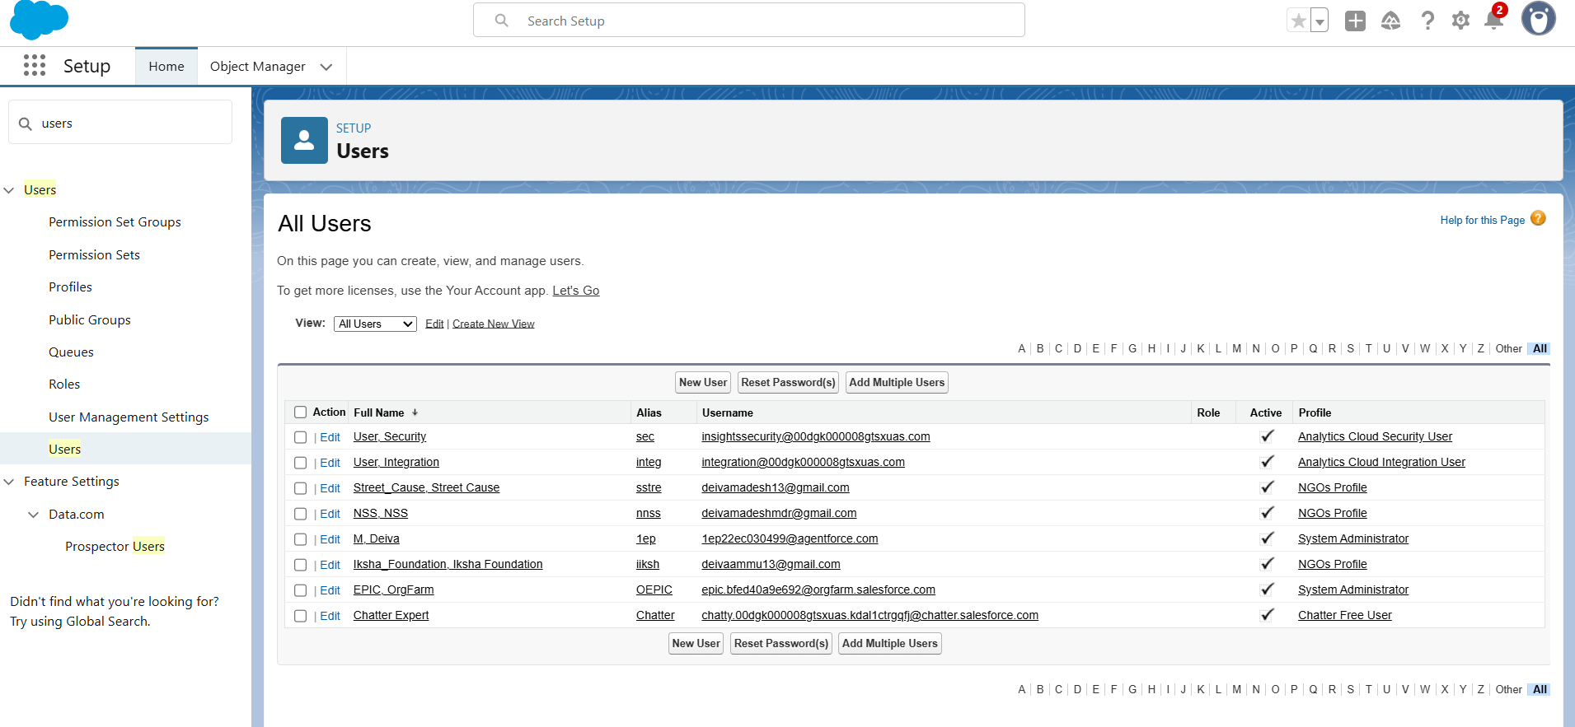
Creation of Users

Slide 15
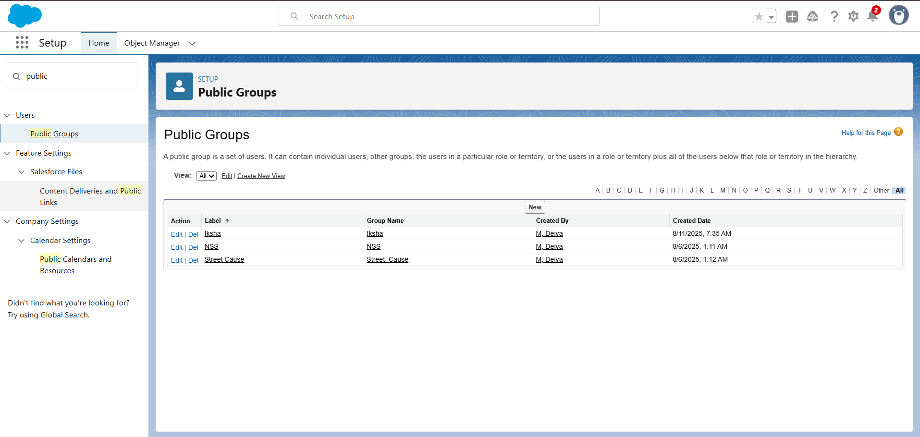
Public Groups

Slide 16
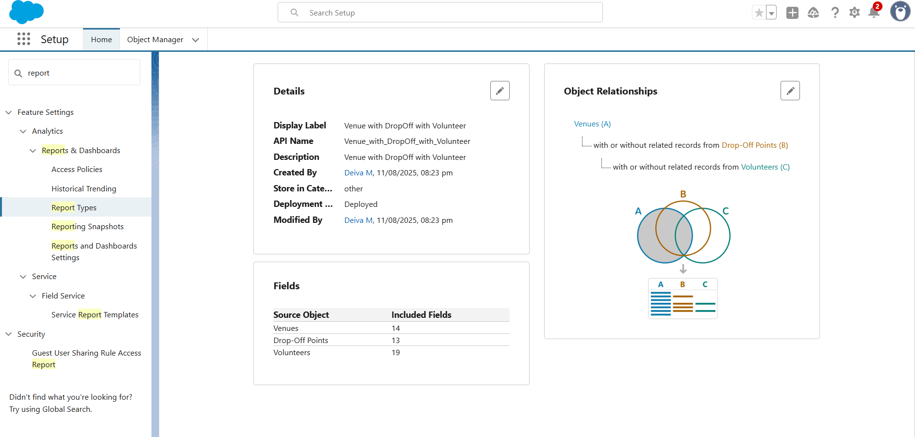
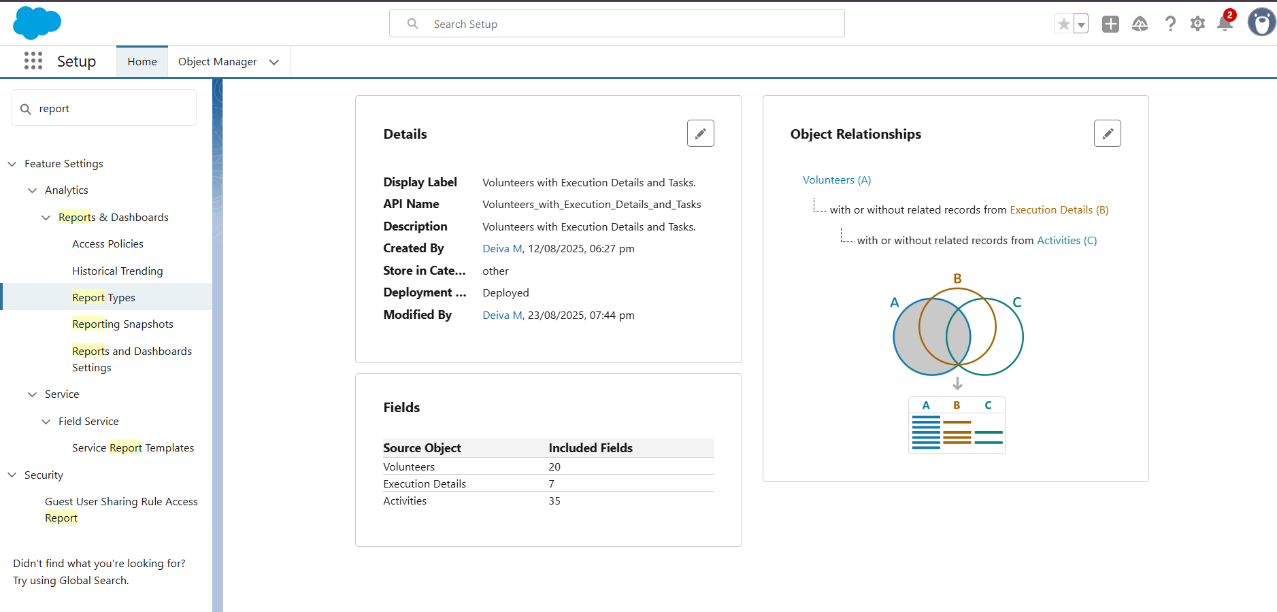
Report Types

Slide 17
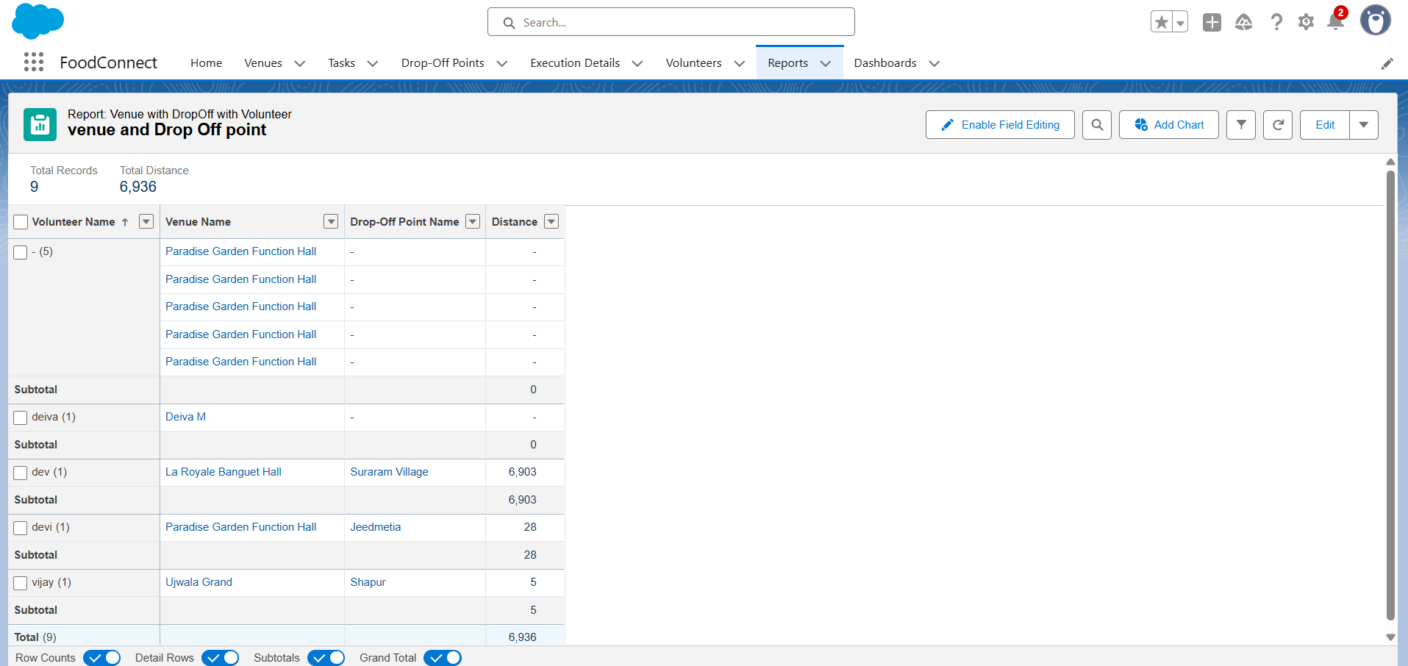
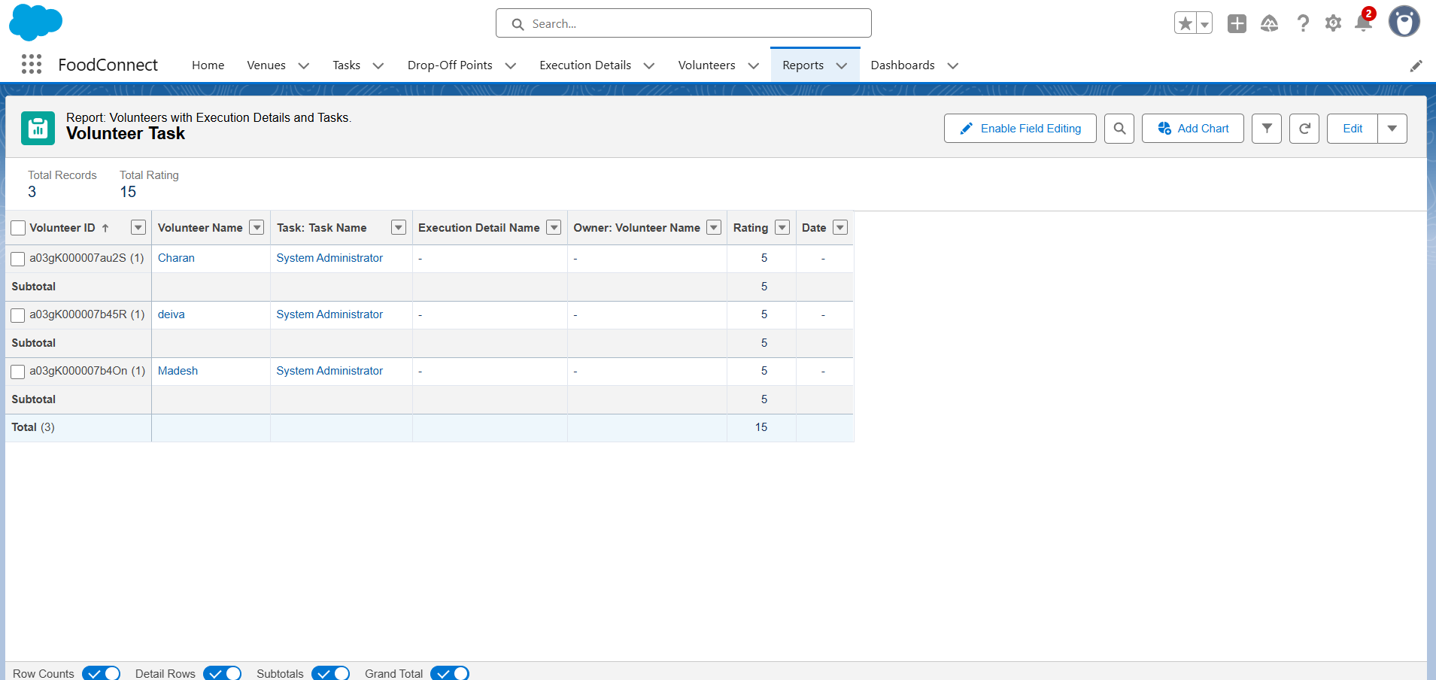
Reports

Slide 18
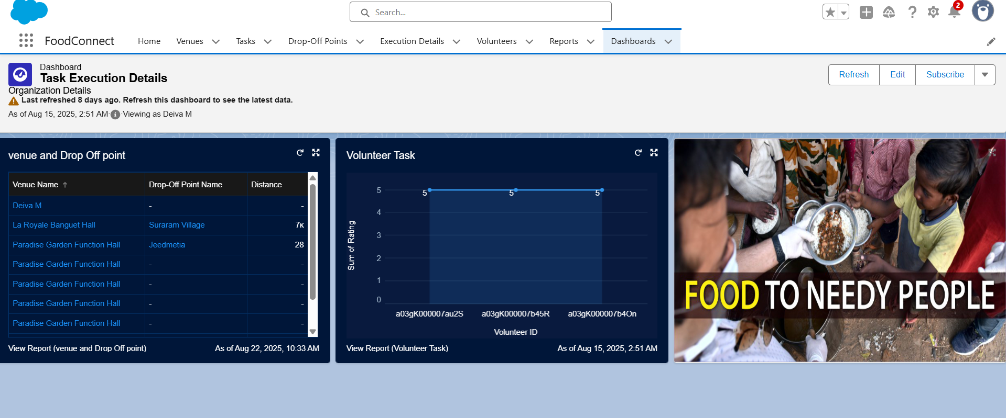
Dashboards

Slide 19
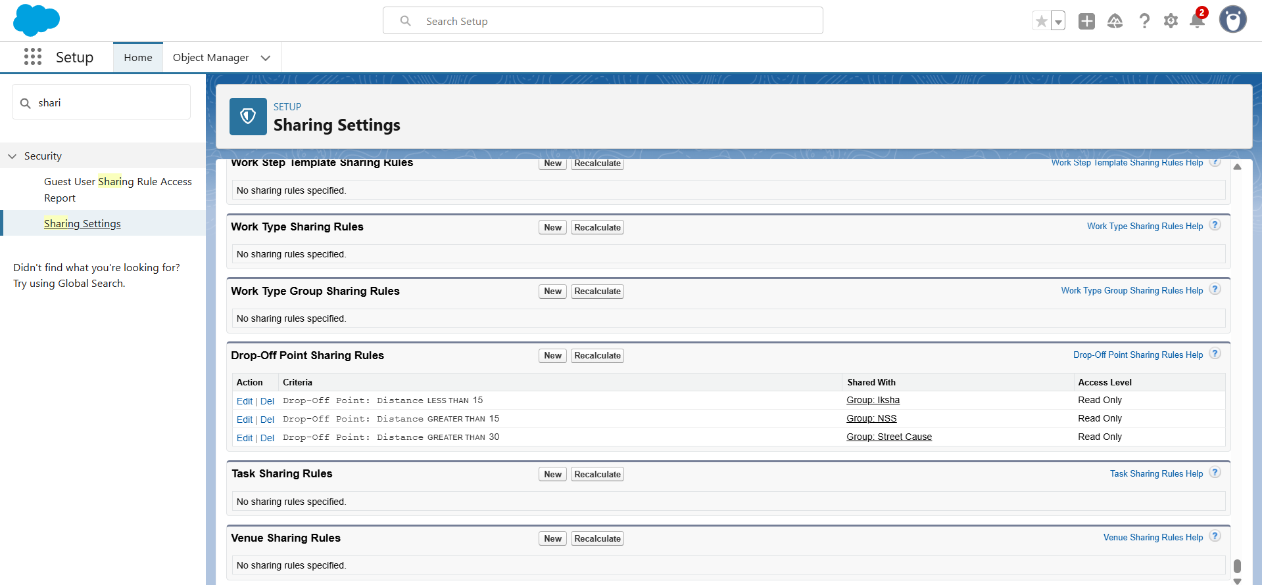
Sharing Rules

Slide 20
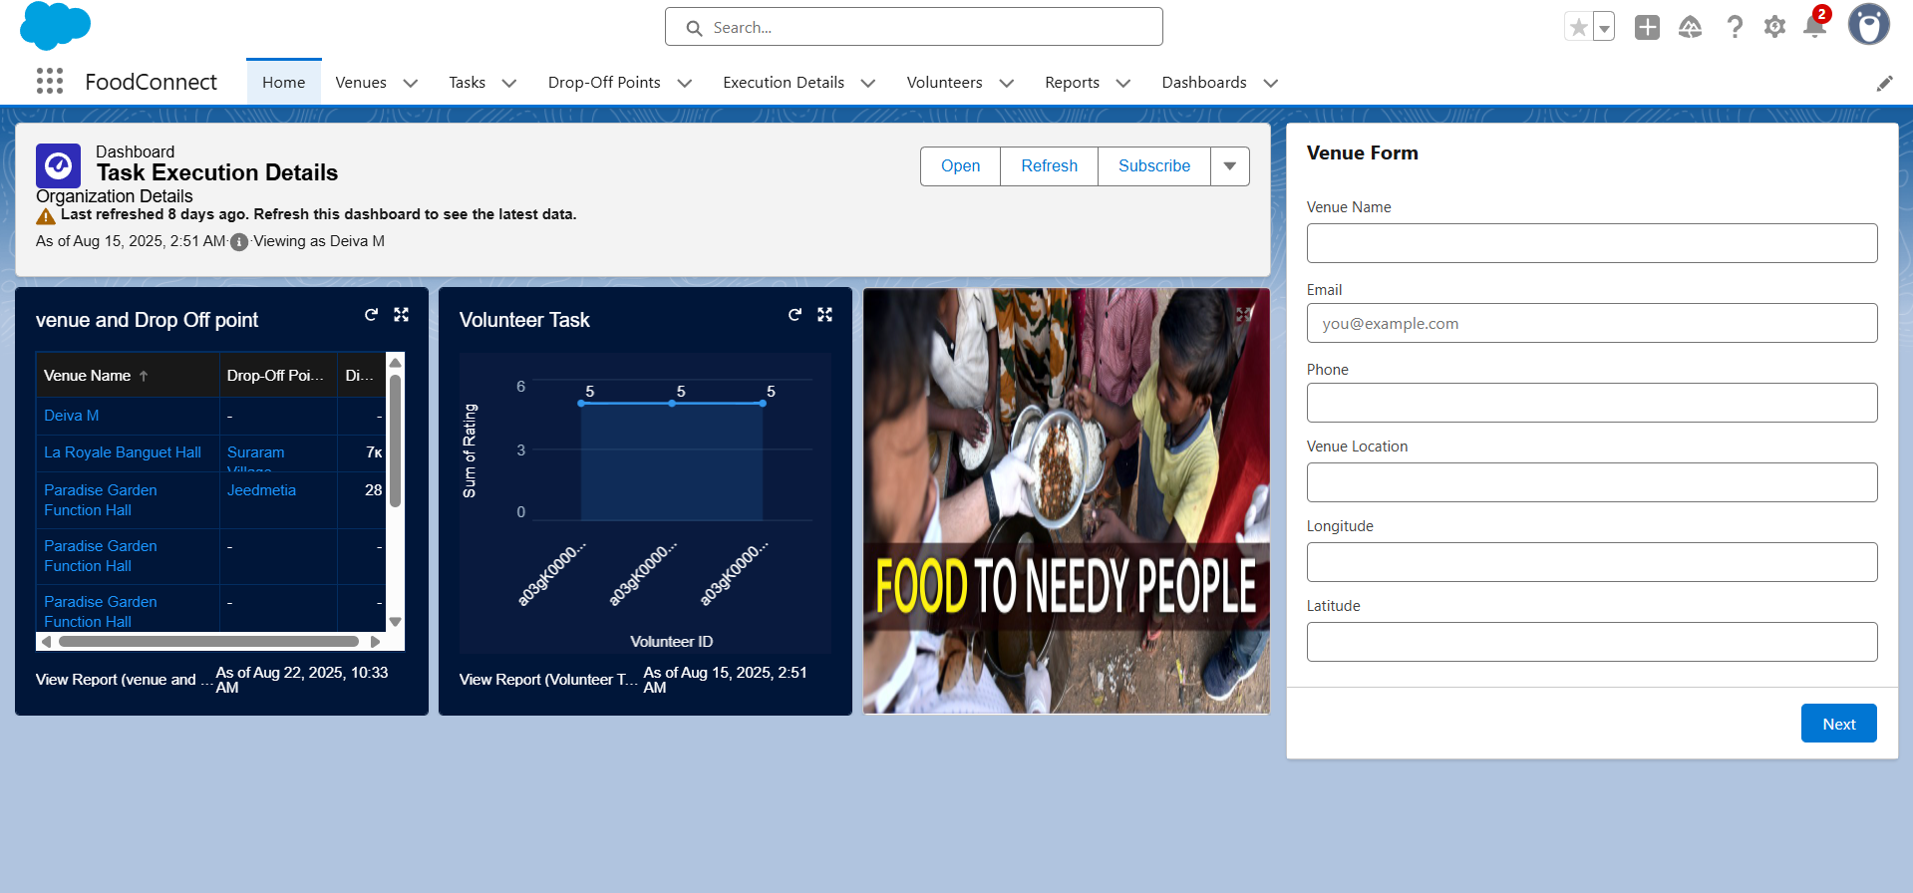
Home Page
Customized home page for the app.

Slide 21
Conclusion
By leveraging the Salesforce platform, the project successfully established a streamlined and transparent system for managing surplus food donations. Through efficient coordination with volunteers and timely delivery to beneficiaries, the project effectively addressed food insecurity while maximizing the utilization of available resources.
Summarize: How Salesforce app helps reduce food wastage & fight hunger.
Future scope: Mobile app integration, AI prediction of demand.

Slide 22
Thank you

